Slide 1
ENVIRONMENTAL POLLUTION AND ENDOMETRIOSIS
Giancarlo Ugazio¹⁾ & Xenia Tkacova²⁾
¹⁾ Formerly Full Professor in General Pathology in the Medical School of Torino University (Italy) (1976-2007)
²⁾ Research Assistant of the first author.

Slide 2
Endometriosis is another devastating clinical condition, similar to MCS (Multiple Chemical Sensitivity), not only for the etiology, largely related to environmental pollutants, but also and especially for the brutality of the conspiracy of silence, by collusion between the medical profession and the entrepreneurial business.
Today, approximately three million Italian women, fourteen million European women, and one hundred fifty million World women are affected by endometriosis.

Slide 3
Essentially, endometriosis is the consequence of a natural biological error in the disposal of body structures, originally put into the field by nature with the purposes of maintenance of the human species, i.e. embryo implantation in the uterine lining, made unnecessary by the absence of fertilization.

Slide 4
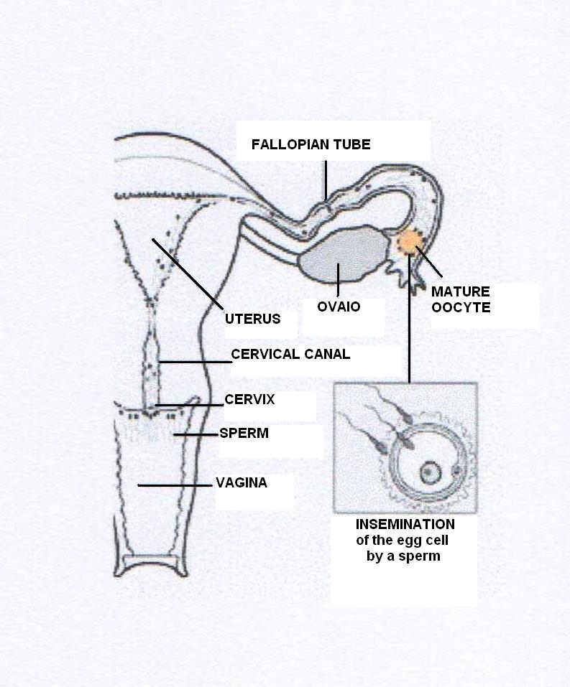

Slide 5
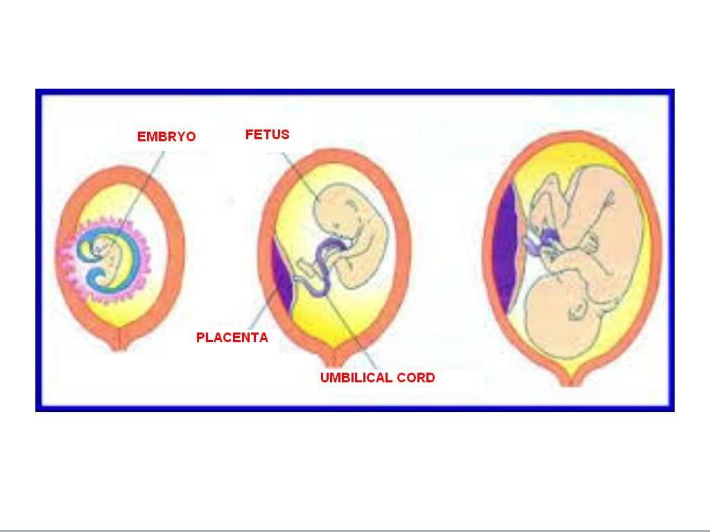

Slide 6
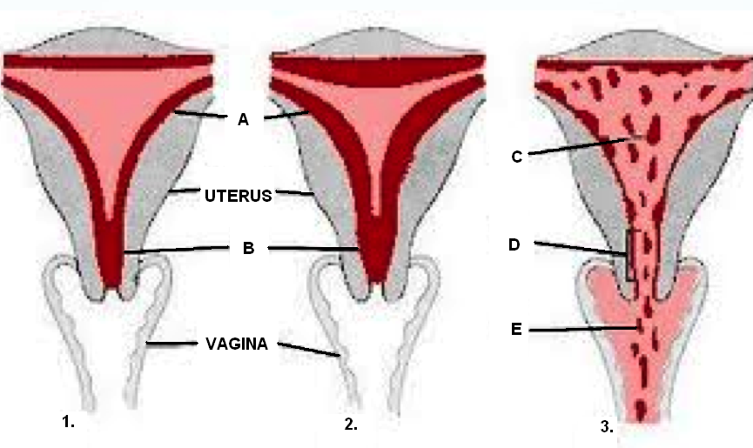

Slide 7
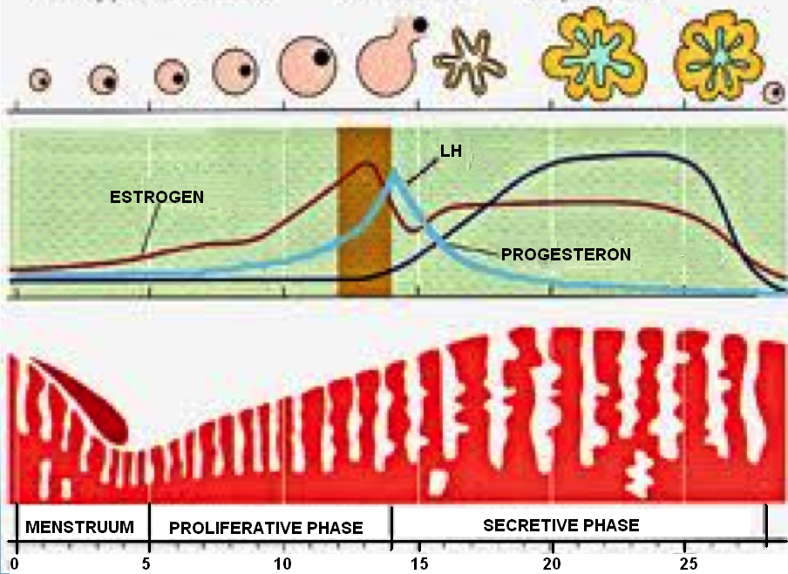

Slide 8
In pathology, endometriosis is a kind of retrograde menstruation leading microscopic fragments of decidual mucosa to locate in places where they should never have to stay: the peritoneum, fallopian tubes, ovaries, and sometimes the pleura.

Slide 9
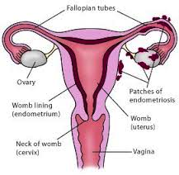

Slide 10
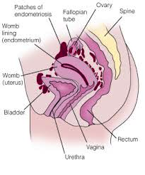

Slide 11
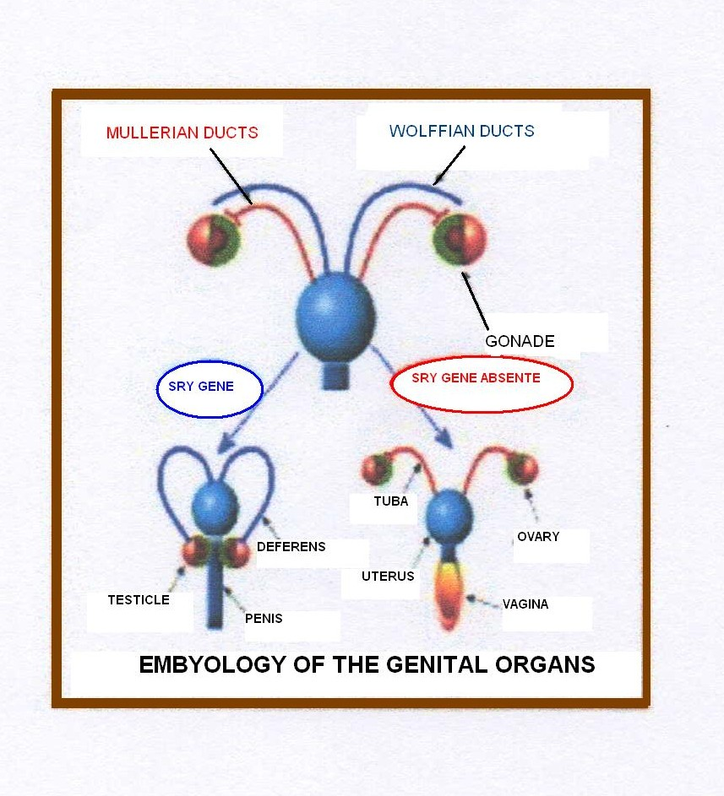

Slide 12
Such ectopia causes pathological phenomena wich, occasionally, are not negligible, both from a subjective point of view (pain) and objective (tumor). One thing is that the biomedical morbidity manifests the affection of a family based susceptibility, then a genomic contribution is undeniable, and reminds those of MCS and diseases caused by asbestos.

Slide 13
In truth, the modern biomedical science offers a decent wealth of information on the possible causative factors of this biological error. For example, they tell us that the chlorine derived from bleaching products, so widespread in modern life, with their daughter dioxin, talc used in hygiene sprays, as well as asbestos, particularly those fibrils that contaminate the drinking water delivered by water supply pipes made by Eternit®, along with phthalates, which are largely diffused in a lot of consumer products, can be considered among the most likely pathogens for the onset of endometriosis (400,000 tons of phthalates are produced and used every year around all the world) .

Slide 14
POSSIBLE ENVIRONMENTAL PATHOGENS
FOR ENDOMETRIOSIS
PRODUCTS for BLEACHING, chlorine-based, used in the preparation of the raw materials of menstrual tampons.
DIOXINS, derived from their precursor chlorine.
TALC, as such or added with boric acid.
ASBESTOS, contaminant of drinking water delivered by water supply pipes made by Eternit ® directly used for personal hygiene or for washing clothing, especially underwear.
PHTHALATES, used as softeners.

Slide 15
As always, in environmental pathology, it is necessary to take into account the additional risks related to the cocktail effect (i.e. toxicological synergism + enhancement, a contribution effect). All this knowledge may allow effective primary prevention, through a wise awareness. Unfortunately, the conspiracy of silence rows in favor of ignorance, resignation, and consideration that endometriosis is the result of a fatality and/or bad luck. Even in this case, a perverse combination of ignorance + conflict of interests is at the basis of this approach so detrimental to the health.

